Slide 1

Brand Promotion and Sales Analysis of Amrita Consumer Food Products Limited
Md. Remon Hasan
Roll: 01-033-11

Slide 2

About Us
Amrita Consumer Food Products Limited is a prominent player in the Bangladesh food industry, known for its diverse range of high-quality consumer food items. As competition in the market intensifies, effective brand promotion strategies become crucial for distinguishing the company from its competitors and driving sales growth. This analysis delves into Amrita's brand promotion techniques, evaluating their effectiveness in reaching target audiences and enhancing brand visibility.
Additionally, the sales performance of Amrita's products will be examined to understand the impact of promotional efforts on consumer purchasing behaviour. By assessing these elements, the analysis aims to provide insights into the current market positioning of Amrita and identify opportunities for future growth.
Amrita Consumer Food Products Limited

Slide 3

Background of the Project
In a highly competitive market characterized by rapidly changing consumer behaviours and preferences, effective brand promotion and sales strategies are essential for sustaining growth and market relevance. This project focuses on analyzing Amrita's current brand promotion efforts and their impact on sales performance. It aims to understand how the company positions itself against competitors, evaluates pricing strategies, and utilizes various promotional channels to enhance brand visibility and drive sales.

Slide 4

What is Pivot Table?
A pivot table is a tool that is part of Microsoft Excel (and other spreadsheet applications, like Google Sheets) that helps users not only to quickly view and analyze data in a more visual way, but also to just as easily change the arrangement of the data so that it can be seen from multiple perspectives. It is surprisingly, one of the most feared features of Excel, but as you’ll quickly discover, pivot tables are easy to make, fun to use, and extremely helpful and informative.

Slide 5
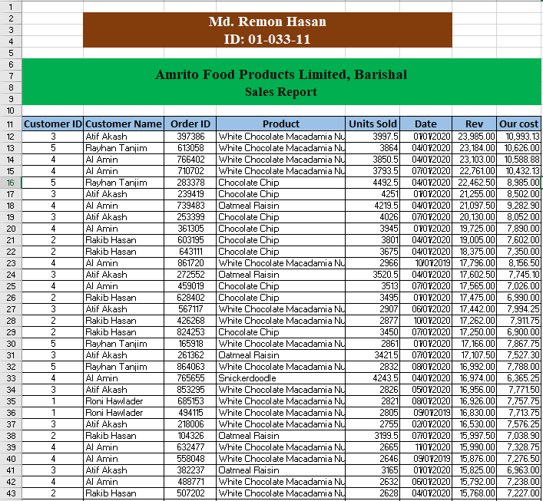
How to Create Pivot Table ?
Before we can make a pivot table, we need data. Your data needs to be arranged in a list or table format. Each column of your data will have a column header or title. So, if your data is a list of how many customers buy products that your company sells to over time, you might have a column for year, quarter, product, and customers (see figure 1).
In order for this data to work for a pivot table, you should have:
• No blank rows or columns,
• No data outside of the list (in other rows or columns), and
• Each column should have a header.
Finally, it is best if your list of data is actually formatted as a table. By formatting your data as a table, you will be able to add to the data and have it easily incorporated into the pivot table. Without formatting as a table, you would need to redefine your pivot table every time you add new data.

Slide 6

Sources of Data
Sources of Data collection
To complete this report, information are collected from both secondary and primary sources.
Primary source
Questionnaire Method: According to the direction of my supervisor, firstly I prepared a questionnaire related to my topic on Amrita Consumer foods Product Limited.
Secondary Sources
I have also collected some data from secondary sources that are given below:
Documentations.
Website of Amrita Consumer foods Product Limited.
Books etc.

Slide 7

Limitations
When I was working in Amrita to prepare my report then I faced so many problems. Those are:
Unwillingness to provide information and vague answer from respondents.
As they are local brand organization, they do not take information and conduct research.
Secondary data is not available.
Lack of much experience.
Short range of business.
Amrita tried to show layout but clients are not satisfied.
Low investment intention for high risk.

Slide 8
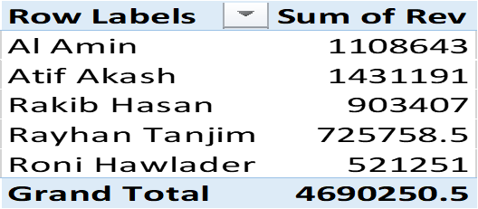
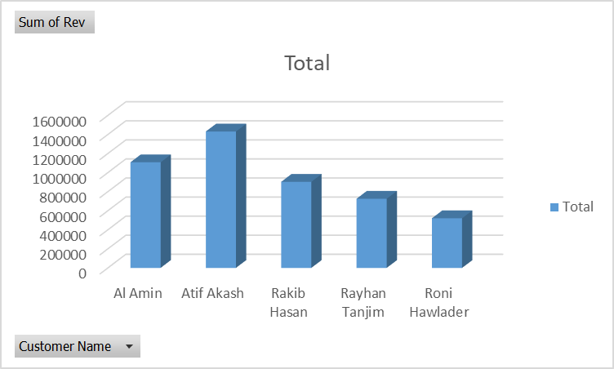
Analysis 1: Which customer generated the highest total revenue across all their orders?
The chart represents the total revenue generated by five customers: Al Amin, Atif Akash, Rakib Hasan, Rayhan Tanjim, and Roni Hawlader.
• Atif Akash has the highest revenue, reaching approximately 1,431,191.
• Al Amin follows as the second-highest revenue generator at around 1,108,643.
• The revenues for Rakib Hasan, Rayhan Tanjim, and Roni Hawlader are lower, with respective totals of 903,407, 725,758.5, and 521,251.
• The chart effectively illustrates the comparative revenue performance among these customers, with clear visual distinctions highlighting Atif Akash's leading position in revenue generation.

Slide 9
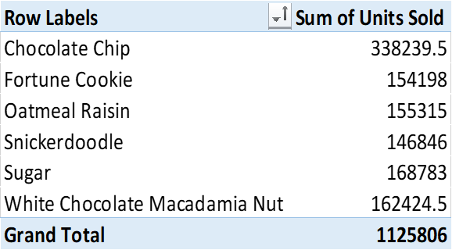
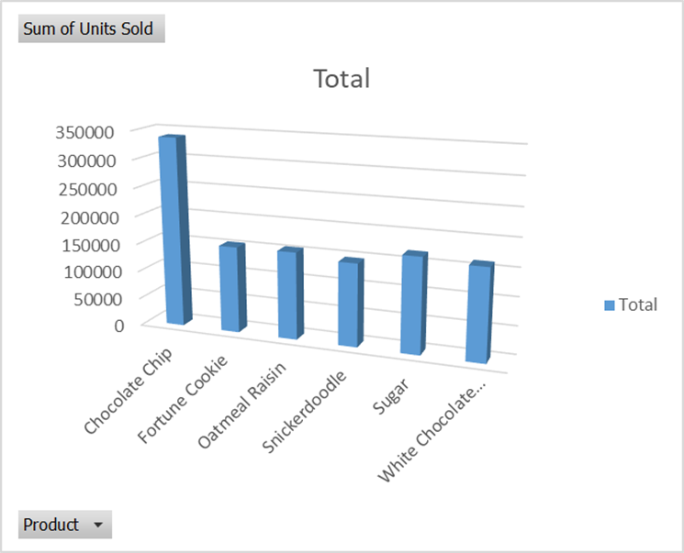
Analysis 2: Which product has the highest sales?
The Chocolate Chip product leads in sales with a total of 338,239.5, making it the highest-selling item. Other notable sales figures include Sugar at 168,783, White Chocolate Macadamia Nut at 162,424.5, Oatmeal Raisin at 155,315, Fortune Cookie at 154,198, and Snickerdoodle at 146,846. Overall, the Grand Total sales across all products amount to 1,125,806.

Slide 10
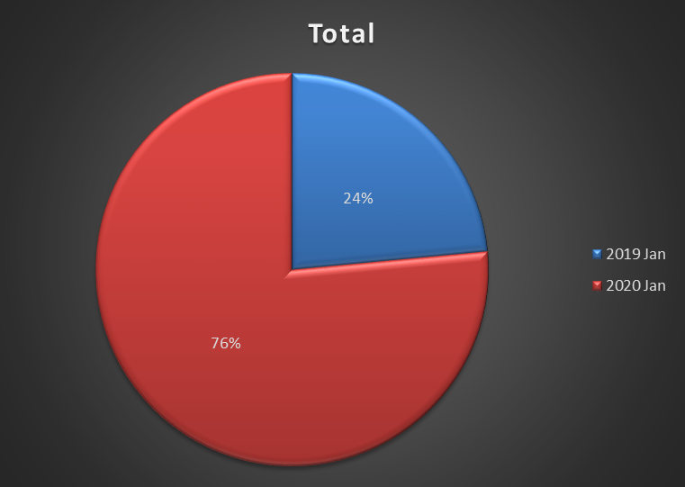
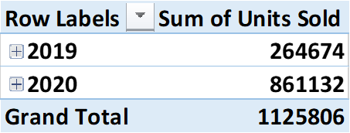
Analysis 3: Which year saw the highest sales in terms of units sold?
The table shows the total units sold in January across two years, 2019 and 2020. In January 2019, 264,674 units were sold, while in January 2020, sales increased significantly to 861,132 units. The grand total for both years combined is 1,125,806 units.
To know about more sales analysis report please see my project report….

Slide 11
Findings
From project it has been found that majority of respondent use only branded product but most of them are not price sensitive customer to Amrita goods.
Amrita Consumer Foods Limited always fulfills its promise which was expressed in various promotional strategies that make consumer loyalty.
It is found that most of the respondent agreed on the perception that quality product of Amrita will help to build a good brand image and they always buy Amrita Consumer Products brand.
Amrita has got good word of publicity and advertisement of Amrita makes consumers notice as a brand and most of the respondent always buy Amrita Consumer Products brand.
If Amrita endorse favorite celebrity in promotion that will positively affect the brand perception.
The price of the Amrita products is affordable by people and Sponsorship helps Amrita build stronger bran.

Slide 12

Large image
Recommendations
Amrita should always pay attention on consumer needs and demand and produce product according to consumer desires that will be helpful for the organization in brand promotion.
Amrita should endorse favorite celebrity and emotional appeal for brand promotional activities that will be effectual for them.
Amrita should modernize their promotional strategies and should increase their brand promotional activities.
Amrita can use social media advertising to reach their consumer easily and it should accept digital media technology as promotional tools.

Slide 13




Thank You
Md. Remon Hasan
remonmkt@gmail.com
Roll: 01-033-11

